Slide 1
An Analytical Placement Algorithm with Routing topology Optimization
Min Wei, Xingyu Tong, Zhijie Cai, Peng Zou, Zhifeng Lin and Jianli Chen
State Key Lab of ASIC & System, Fudan University, Shanghai 200433, China
Center for Discrete Mathematics and Theoretical Computer Science, Fuzhou University, Fuzhou 350108, China
Presenter : Min-Feng Hsieh
Advisor : Ting-Chi Wang

Slide 2
Outline
Introduction
Preliminaries
Proposed Algorithm
StWL Optimization in Global Placement
StWL Optimization in Cell Refinement
Experimental Result

Slide 3
Outline
Introduction
Preliminaries
Proposed Algorithm
StWL Optimization in Global Placement
StWL Optimization in Cell Refinement
Experimental Result

Slide 4
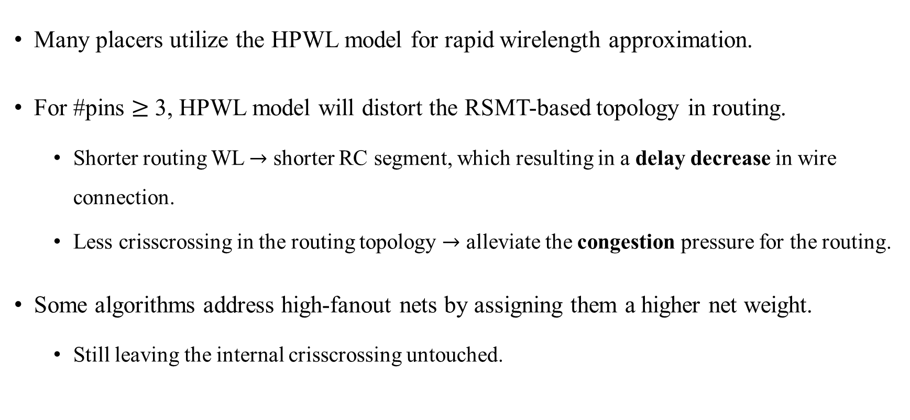
Introduction
Many placers utilize the HPWL model for rapid wirelength approximation.
For #pins $≥$ 3, HPWL model will distort the RSMT-based topology in routing.
Shorter routing WL $→$ shorter RC segment, which resulting in a delay decrease in wire connection.
Less crisscrossing in the routing topology $→$ alleviate the congestion pressure for the routing.
Some algorithms address high-fanout nets by assigning them a higher net weight.
Still leaving the internal crisscrossing untouched.

Slide 5
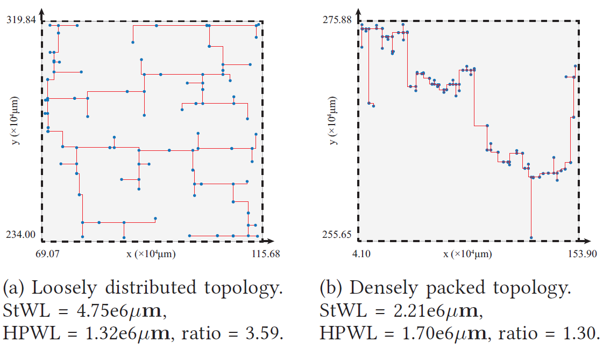
Introduction
The rectilinear Steiner minimal tree (RSMT) is an optimal topology that can accurately approximate the routing wirelength.
StWL: RSMT wirelength
Notes:
圖a的inner point (藍色點)比較稀疏 -> HPWL低，但是StWL高 (因為她的steiner tree遍布整個bounding box)
圖b的inner point (藍色點)比較密集 -> HPWL變高，但是StWL變低

Slide 6
Outline
Introduction
Preliminaries
Proposed Algorithm
StWL Optimization in Global Placement
StWL Optimization in Cell Refinement
Experimental Result

Slide 7
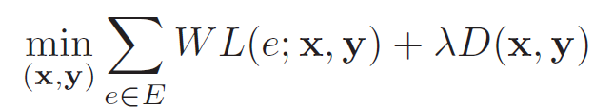

Preliminaries - WL-Driven Analytical Placement
The placers construct a minimization problem of the total wirelength under the cell density constraints.
Objective function:
$E:$Complete set of the net in the design
$\left(x, y\right):$the cell location
$λD\left(x, y\right):$density penalty term with density penalty weight $λ$

Slide 8
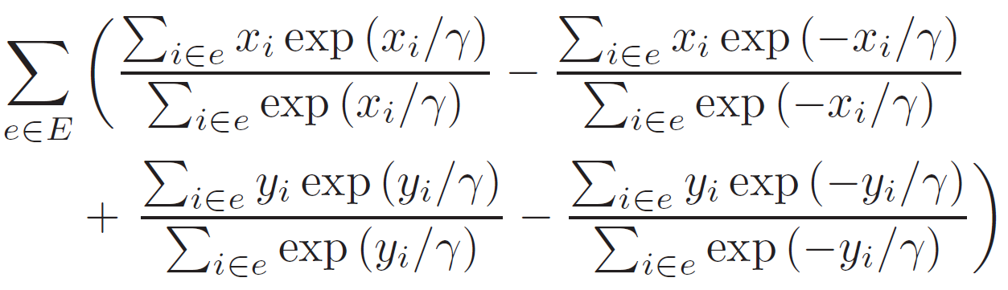
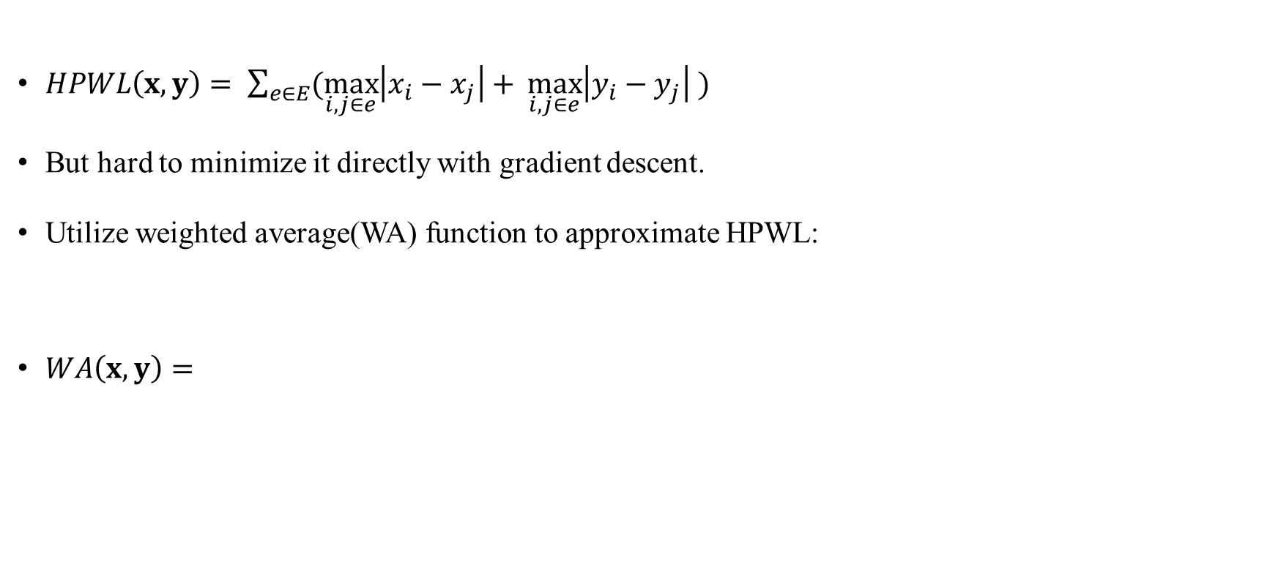


Preliminaries - HPWL Wirelength Model
$HPWL\left(x,y\right)= \sum_{e∈E}{(\max_{i,j∈e}\left|x_{i}−x_{j}\right|+ \max_{i,j∈e}\left|y_{i}−y_{j}\right| )}$
But hard to minimize it directly with gradient descent.
Utilize weighted average(WA) function to approximate HPWL:
$WA\left(x,y\right)=$
$$↑$$
$$γ=maxterm in x \left(y\right)direction$$
$$↑$$
$$γ=minterm in x \left(y\right)direction$$
Notes:
i, j are different pins of the specific net e

Slide 9
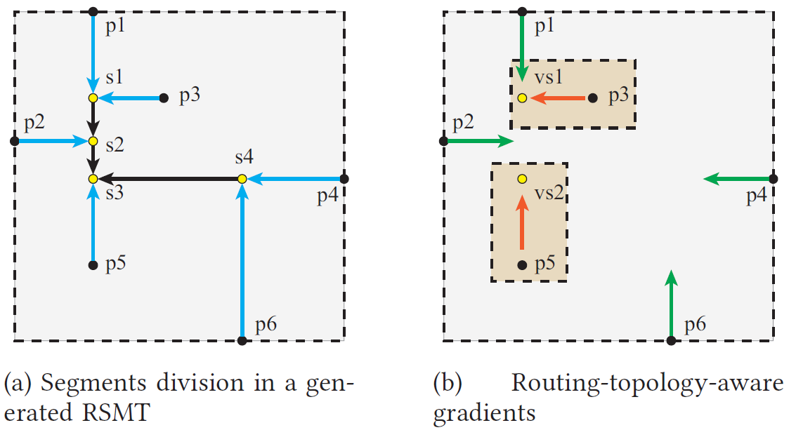
Preliminaries - Analysis of HPWL & RSMT Topology
HPWL model ignores the distribution of interior points, thus losing track of the practical gradient guidance.
Branches :
Directly connected to the input and
output pins (Physical pins).
Trunks :
The remaining part composed
of Steiner points.
trunk
branch
Notes:
(b)圖中的綠色箭頭是HPWL Model的wirelength gradient (只有p1,p2,p4,p6有，其他的interior point 沒有)
Internal point的意思是說被HPWL的bounding box關起來，並且沒有在bounding box上的那些店(e.g. p3, p5)

Slide 10
Outline
Introduction
Preliminaries
Proposed Algorithm
StWL Optimization in Global Placement
StWL Optimization in Cell Refinement
Experimental Result

Slide 11
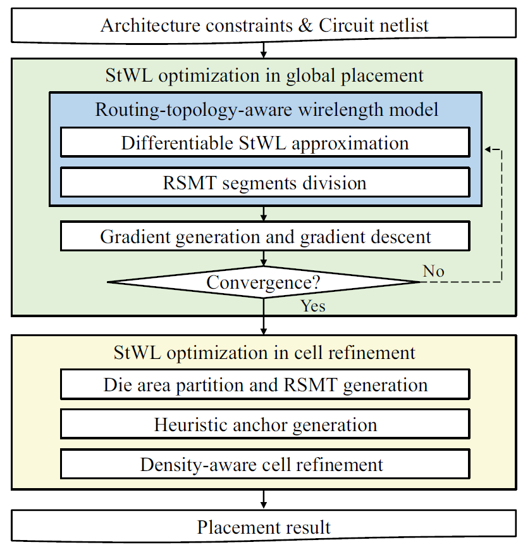
Proposed Algorithm
StWL Optimization in Global Placement.
StWL Optimization in Cell Refinement.
Notes:
他一開始會將internal point用StWL的方式來近似，並且做gradient descent，得到HPWL model沒有考慮到的gradient

Slide 12
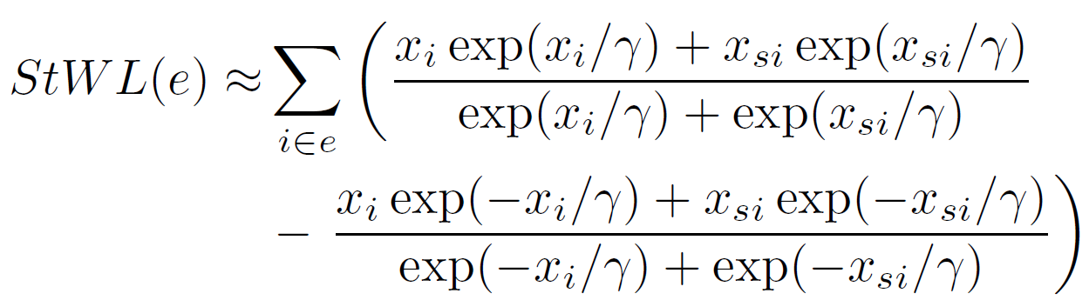

Proposed Algorithm - StWL Optimization in GP
Differentiable StWL Approximation
$StWL\left(e\right)= \sum_{i∈E}{|x_{i} − x_{si}|}$
Each segment can be analyzed separately and seen as a 2-pin net.
Weighted average approximation of horizontal StWL for net e:
i : inner point of net e (include steiner points).
si : the parent node of point i.
Notes:
這邊只考慮internal point的wirelength

Slide 13
Proposed Algorithm - StWL Optimization in GP
(2) RSMT segments division
The green arrow is the gradient from the WA wirelength model
Computational efficiency.
Gradient values and directions are pretty close to those provided by StWL model.
To avoids a large number of routing topology analyses.
The arrows between p3 and vs1, p5 and vs2 in the brown
box are the inner gradient for this 6-pin net.
trunk
branch

Slide 14
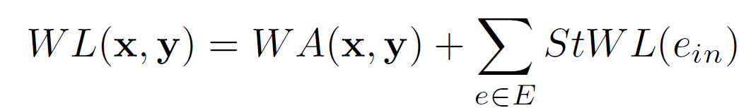
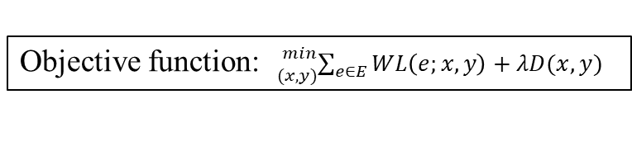

Proposed Algorithm - StWL Optimization in GP
Objective function: ${}_{(x,y)}^{min}{\sum_{e∈E}{WL\left(e;x,y\right)+λD(x,y)}}$
(2) RSMT segments division
It is time-consuming and unnecessary to optimize all parts by a single StWL model.
Assumption: The Steiner points in the topology can be considered fixed in each iteration.
Splits the net into a fixed trunk part and a changeable branch part.
Typically, this assumption is satisfied for most iterations in the GP stage.
Hybrid wirelength model:
trunk
$$e_{in}:interal part of net e$$
branch
Notes:
就是把net分成fixed trunk跟changeable branch.
Branch part可以移動cell來優化，但是trunk part就是那些fixed coordinates的加減，可以視為constant. 所以StWL steiner跟steiner間不會有gradient.
利用Hybrid wirelength model，將WA model可以處理的先處理好(因為速度比較快)，接著那些inner part再用StWL來處理，得到完整的gradient來得到更精準的wirelength.

Slide 15

Proposed Algorithm - StWL Optimization in GP
(3) Gradient descent of our wirelength model
For the interior pins, the hybrid wirelength model can provide gradients to minimize the length of its corresponding segments.
For the pin on the net bound, their shrinking gradient is provided by the $WA(x, y)$term.

Slide 16
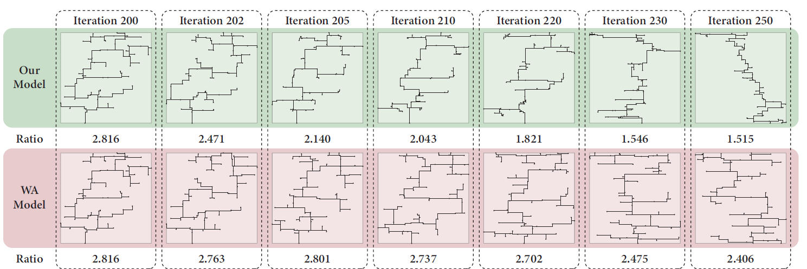

Proposed Algorithm - StWL Optimization in GP
Ratio = $\frac{StWL}{HPWL}$
Notes:
相較於WA Model的net依舊十分混亂，他們的Model會將trunk附近的cell聚集，使的net的內部部分的結構更加整潔
他們model算出來的HPWL與真實的wirelength差不多

Slide 17
Outline
Introduction
Preliminaries
Proposed Algorithm
StWL Optimization in Global Placement
StWL Optimization in Cell Refinement
Experimental Result

Slide 18
Proposed Algorithm - StWL Optimization in Cell Refinement
Analytical placement is “convergence” when cells are scattering with tolerable density violations.
If convergence, further iterations only perform trivial cell displacement.
Aside from gradient descent, there is still room for RSMT refinement with routing-topology-aware wirelength model.
They propose a placement violation refinement algorithm with a heuristic RSMT optimization strategy.
Moving cells to their wirelength-optimal region hastily would obviously deteriorate the low overlap distribution given by analytical global placement.
They proposed bin-level density control in cell movement to keep the incremental refinement swift and plausible.
Notes:
會破壞GP所做出來的solution

Slide 19
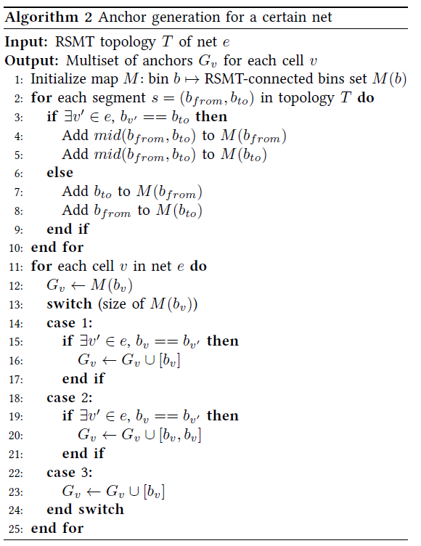
Proposed Algorithm - StWL Optimization in Cell Refinement
Anchor generation for a certain net
Notes:
在每一個level中，在同一個bin(也就是樹的node)的cell都會被看成共享同一個coordinate.

Slide 20
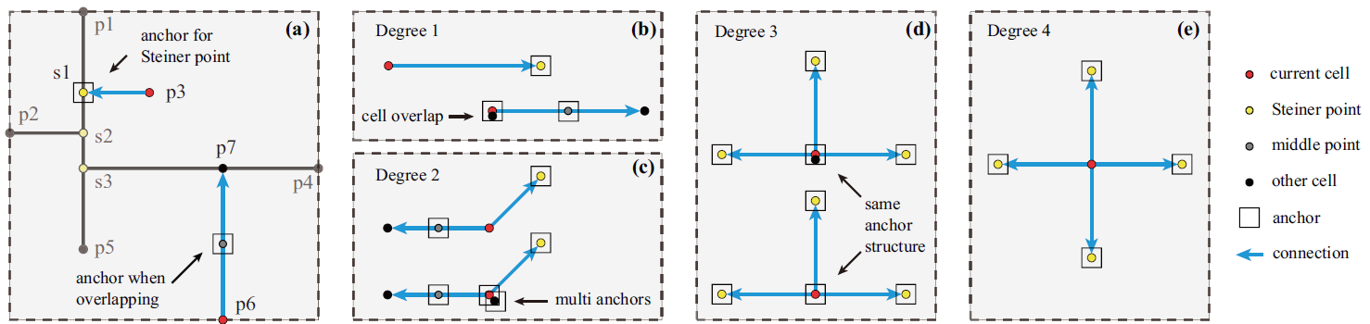

Proposed Algorithm - StWL Optimization in Cell Refinement
If segment is consist of pin + steiner point $→$ anchor is on the steiner point.
If segment is consist of pin + pin $→$ anchor is on the steiner point.
If 2 pins is in the same bin $→$ need additional one anchor

Slide 21
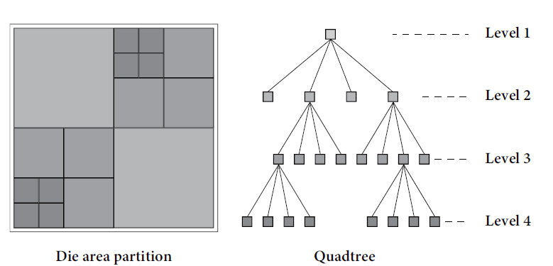
Proposed Algorithm - StWL Optimization in Cell Refinement
(2) Framework of the refinement algorithm
Utilize branch and bound method for swift density check.
The whole die is divided into four identical coarse bins.
Use a quadtree to store the available area of the four bins in each node.
Each child node regions will continue to be divided until the finest bin granularity (5-10 times the row height).
The cells in the same bin are considered to share the same coordinates at each granularity.
Notes:
在每一個level中，在同一個bin(也就是樹的node)的cell都會被看成共享同一個coordinate.

Slide 22
Proposed Algorithm - StWL Optimization in Cell Refinement
(2) Framework of the refinement algorithm
For each cell, the algorithm traverses the quadtree to find potential regions with enough area.
If the node bin does not have enough area, it will drop out of the set of candidate region.
At each level, the final optimal region that the traversing algorithm shall step into is determined by a pessimistic cost function based on RSMT topology
After the cell is moved into its optimal region, the density of nodes affected throughout the quadtree will update accordingly.

Slide 23
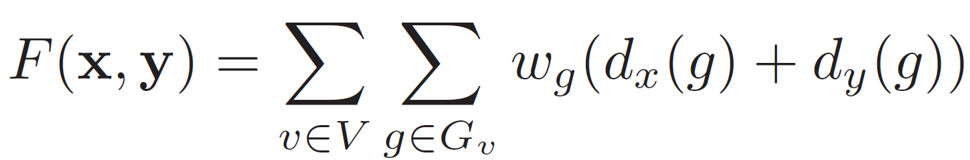
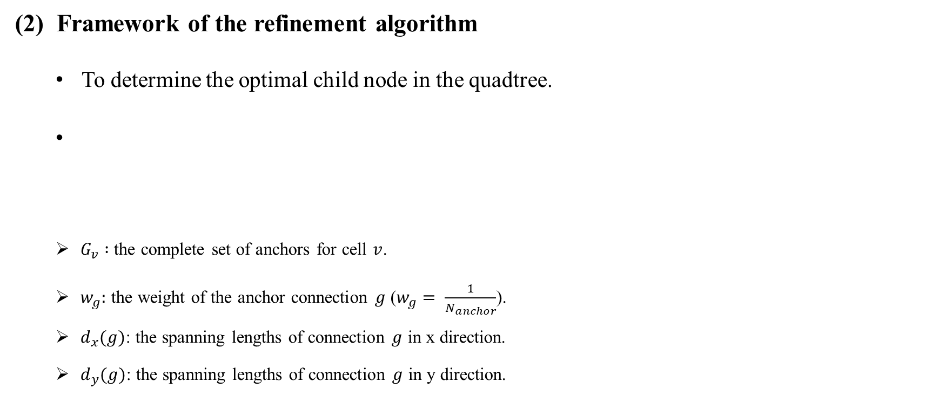
Proposed Algorithm - StWL Optimization in Cell Refinement
(2) Framework of the refinement algorithm
To determine the optimal child node in the quadtree.
$G_{v} :$the complete set of anchors for cell $v$.
$w_{g}:$ the weight of the anchor connection $g$ ($w_{g}= \frac{1}{N_{anchor}}$).
$d_{x}(g)$: the spanning lengths of connection $g$ in x direction.
$d_{y}(g)$: the spanning lengths of connection $g$ in y direction.
Notes:
是算總電路的結果
對於每一個node，都會去看他所擁有的anchor.
計算方法為weight去乘上cell到anchor的Manhattan distance.

Slide 24
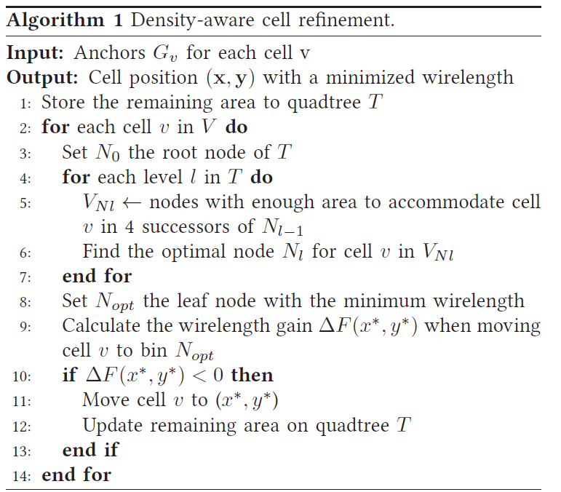
Proposed Algorithm - StWL Optimization in Cell Refinement
Notes:
這是一個密度感知的單元微調算法，用於在電路布局中最小化線長。以下是算法的簡要解釋：
1. **輸入：** 對於每個單元 v，提供了一組錨點 Gv。
2. **輸出：** 優化後的單元位置 (x, y)，以實現最小化線長。
算法步驟：
1. **初始化：** 使用一個四叉樹 T 存儲剩餘的區域。四叉樹是一種分區數據結構，用於有效地組織和查詢空間中的信息。
2. **遍歷每個單元：** 對於每個單元 v：
- 從根節點開始，遍歷四叉樹的每一層（level）。
- 在每個層級，找到足夠容納單元 v 的區域節點。
- 在這些節點中找到最優的節點 Nl(F(x,y)最小)，以最小化單元 v 的線長。
3. **更新節點：** 選擇在最低層的節點 Nopt，該節點具有最小的線長。
4. **計算線長增益：** 計算當將單元 v 移動到節點 Nopt 時的線長增益 ΔF(x∗, y∗)。
5. **移動單元：** 如果線長增益 ΔF(x∗, y∗) 為負，則將單元 v 移動到位置 (x∗, y∗)。
6. **更新四叉樹：** 更新四叉樹 T 中的剩餘區域。
簡而言之，該算法通過遍歷四叉樹，找到每個單元的最優位置，以最小化線長。如果新位置導致線長減少，則移動該單元。

Slide 25
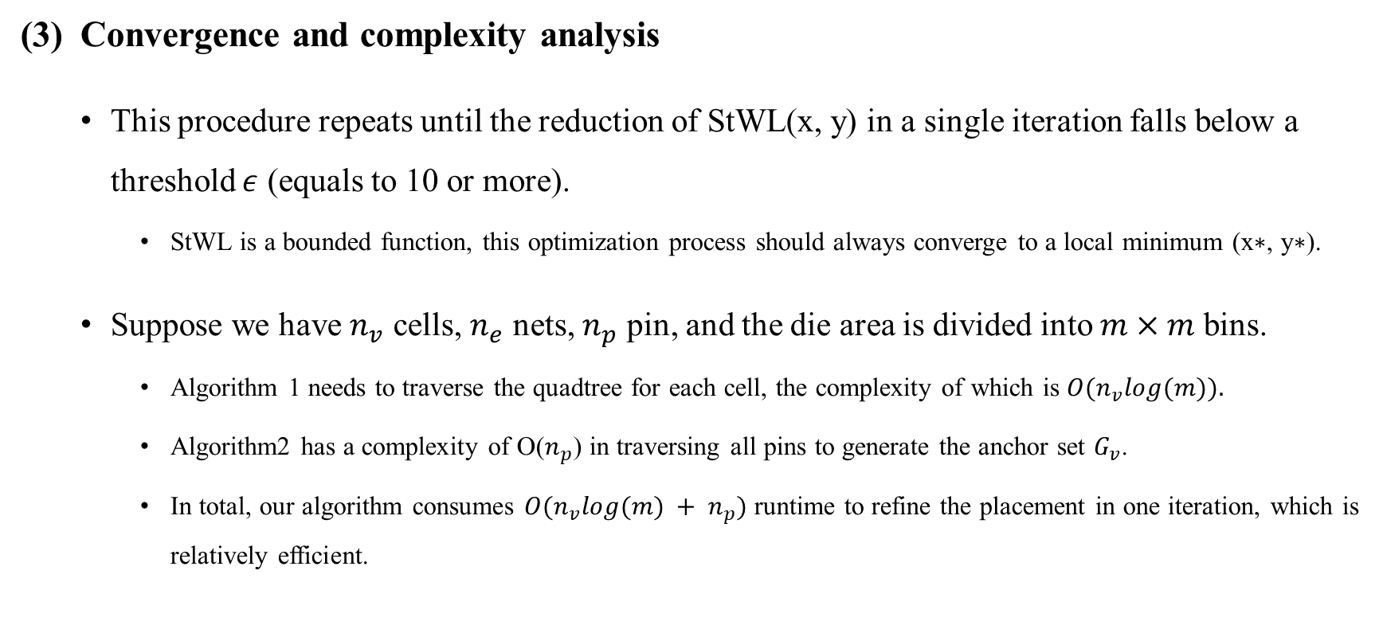
Proposed Algorithm - StWL Optimization in Cell Refinement
Convergence and complexity analysis
This procedure repeats until the reduction of StWL(x, y) in a single iteration falls below a threshold $ε$ (equals to 10 or more).
StWL is a bounded function, this optimization process should always converge to a local minimum (x∗, y∗).
Suppose we have $n_{v}$ cells, $n_{e}$ nets, $n_{p}$ pin, and the die area is divided into $m×m$ bins.
Algorithm 1 needs to traverse the quadtree for each cell, the complexity of which is $O(n_{v}log(m)).$
Algorithm2 has a complexity of O($n_{p}$) in traversing all pins to generate the anchor set $G_{v}$.
In total, our algorithm consumes $O(n_{v}log(m) + n_{p})$runtime to refine the placement in one iteration, which is relatively efficient.
Notes:
在每一個level中，在同一個bin(也就是樹的node)的cell都會被看成共享同一個coordinate.

Slide 26
Outline
Introduction
Preliminaries
Proposed Algorithm
StWL Optimization in Global Placement
StWL Optimization in Cell Refinement
Experimental Result

Slide 27
Experimental Result
The framework is implemented in C++.
Benchmarks:
ICCAD2015 incremental timing-driven placement contest benchmarks.
Industrial benchmarks.
64-bit Linux machine with 24-core Intel Xeon processors running at 2.4GHz with 8 threads.
Utilize Innovus refinePlace for layout legalization and fine-tuning.
Compared the routed wirelength(RWL) by Innovus earlyGlobalRoute.
Compared the timing metrics by UItimer2.0.

Slide 28
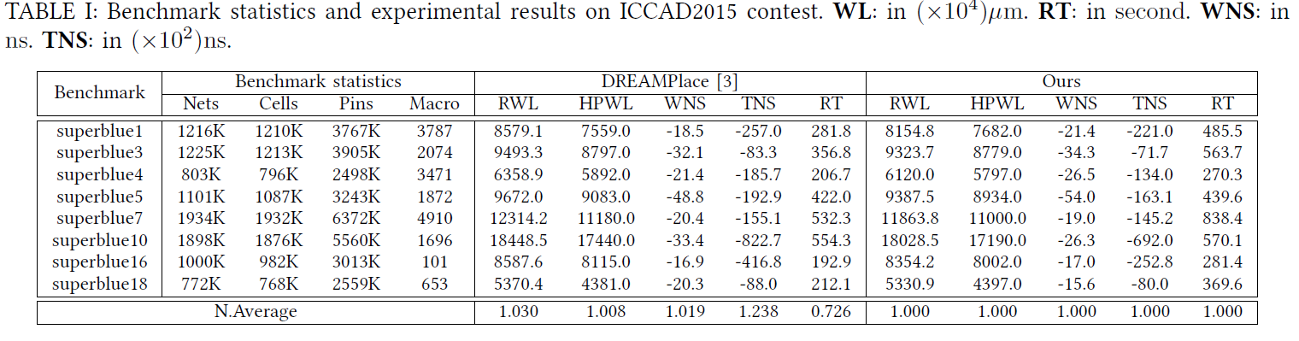
Experimental Result
Notes:
因為沒有特別修復critical net, 所以WNS沒有進步很多
但是Runtime都比較高

Slide 29
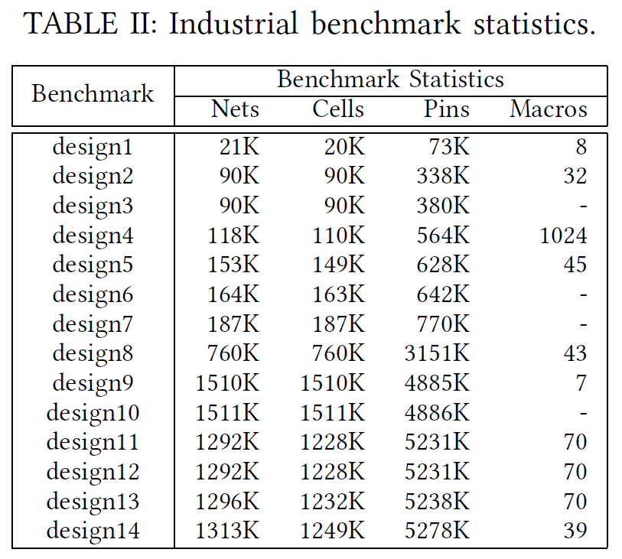
Experimental Result

Slide 30
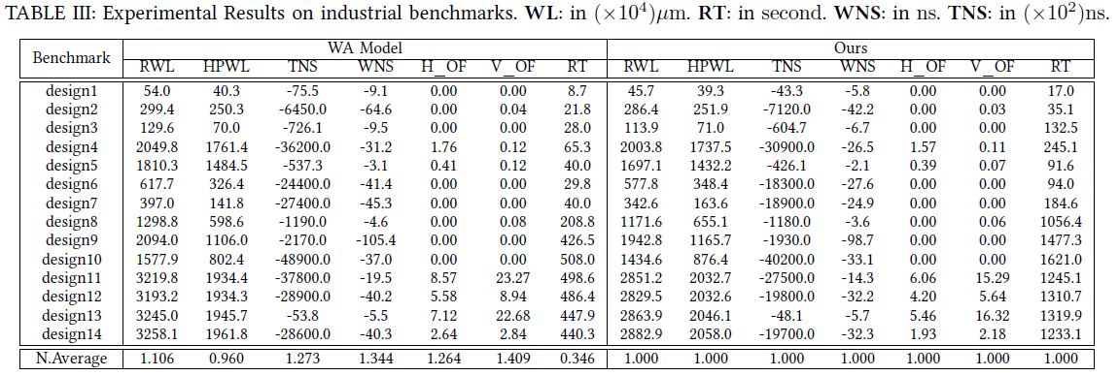
Experimental Result

Slide 31
Thank you for listening!

